Slide 1

Boosting
Ada boost
Algorithm
Summary
LG boost
Intro
XG, LG boost
XG boost

Slide 2



1
2
3
Summary
LG boost
Ada boost
XG BOOST
Intro
XG, LG boost
XG boost
ADA BOOST
LG BOOST

Slide 3
01
ADA BOOST
Summary
LG boost
Ada boost
XG, LG boost
XG boost
Intro
ADA BOOST

Slide 4
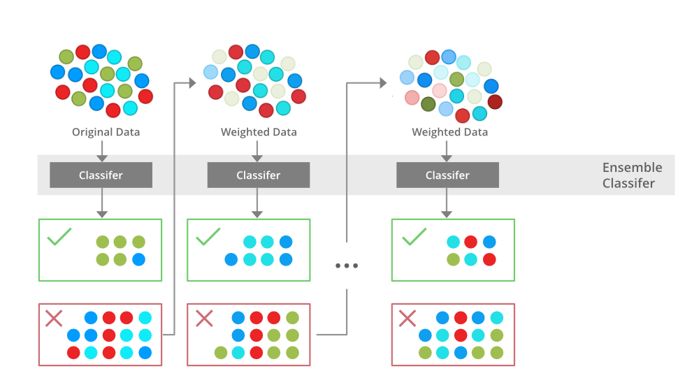
Summary
LG boost
XG, LG boost
XG boost
Intro
Ada boost

Slide 5
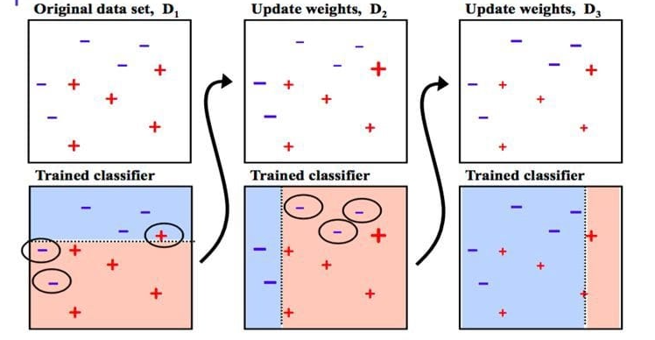
Summary
LG boost
XG, LG boost
XG boost
Intro
Ada boost

Slide 6
XG BOOST
02
Ada boost
Summary
LG boost
XG boost
Intro
XG, LG boost
XG BOOST

Slide 7
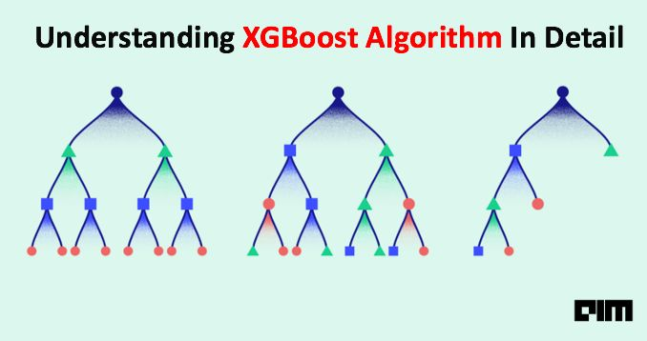
Ada boost
Summary
LG boost
XG boost
Intro
XG, LG boost

Slide 8
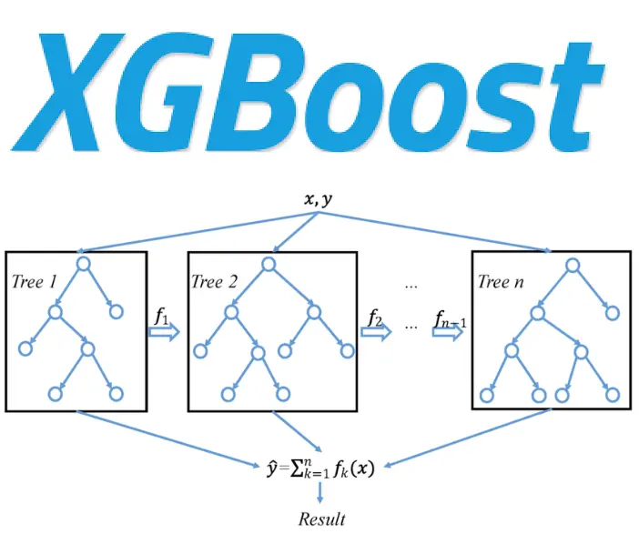
Ada boost
Summary
LG boost
XG boost
Intro
XG, LG boost

Slide 9
LG BOOST
03
Ada boost
Summary
LG boost
Intro
XG, LG boost
XG boost
LG BOOST

Slide 10
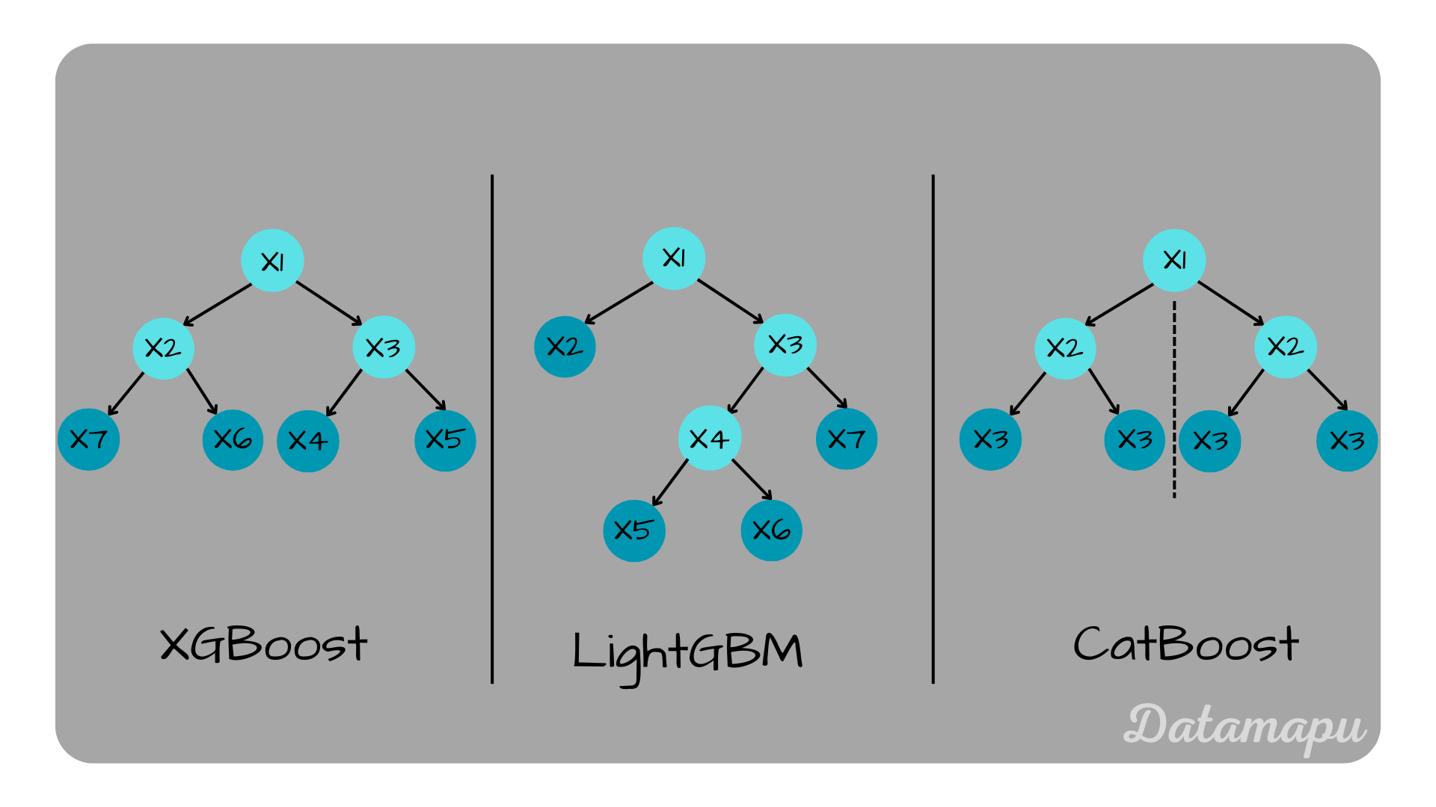
Ada boost
Summary
LG boost
Intro
XG, LG boost
XG boost

Slide 11
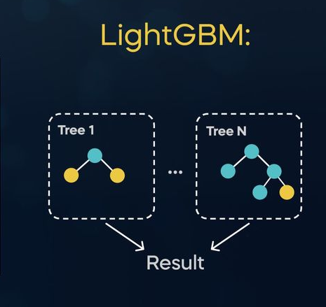
Ada boost
Summary
LG boost
Intro
XG, LG boost
XG boost

Slide 12
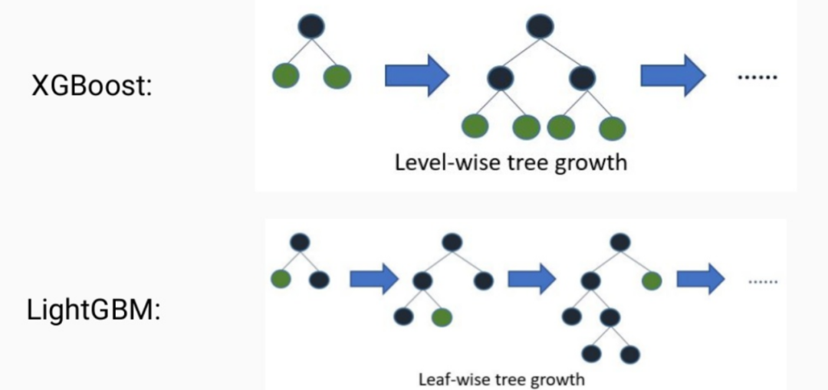
XG, LG boost
Ada boost
Summary
XG boost
Intro
Workflow

Slide 13
ADA BOOST
XG BOOST
LG BOOST
XG boost
LG boost
Ada boost
Summary
Intro
XG, LG boost
A technique that improves a weak model step-by-step to make it strong.
A smart method that grows many strong trees to give the best prediction
A fast algorithm that grows decision trees to make quick and accurate prediction

